Slide 1
E-Way Bill Important Points

Slide 2
Important Points
One Consignment → One Document → One E-waybill
Multiple documents can not be clubbed to generate one e-way bill
One Invoice → Multiple Consignments with Multiple challans → Multiple E-way bills
In case of SKD/CKD/Ship consignments, one invoice will result in making multiple consignment for movements with challans and resulting in multiple e-way bills
Multiple Documents >< One E-way Bill – Not Possible
One e-way bill can not be generated with multiple documents

Slide 3
Important Points
No way the e-way bill can be edited or amended
It can be cancelled within 24 hours if required and generate new
Transportation (vehicle) details can be updated any number of times till the goods reaches the destination within validity period

Slide 4
Important Points
Validity of the e-way bill starts from time of first entry of Part-B (vehicle details), not from the time of generation of e-way bill
E-way bill generated is invalid for movement of goods, if it is not updated with Part-B, if the travel distance is more than 10 KMs
Part-B updation is not must for first and last mile of travel, if the distance is less than 10 KMs
Consolidated E-way bill does not have any specific Validity. It depends upon the e-way bills attached to it.

Slide 5
Important Points
E-way bill for different Bill to and Ship to address ?
One e-way Bill or Two e-way Bills – to be examined

Slide 6
Important Points
For one e-way bill multiple modes of transportation can be updated – like First Ship, then air and road

Slide 7
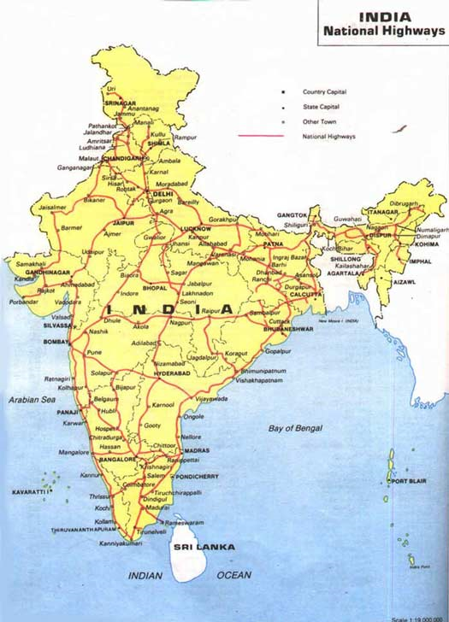
Important Points
Multiple e-way bills passing through transhipment from one place to another in different vehicles to reach the destinations
Sometimes the consignments move to 8-10 branches of the transporter before they reach its destination.
The consignments reach the particular branch of transporter from different places in different vehicles and again these consignments will be split to different places in different vehicles.
Best solution for transhipment of consignment is generation of consolidated ewaybill from one place to another

